Slide 1
Writing Award Winning PowerShell
Functions and Script Modules

Slide 2

Get-Help –Name ‘about_Presenter’
Mike F Robbins
Microsoft MVP
Mississippi PowerShell User Group
PowerShell 101: The No-Nonsense Beginner’s Guide
Windows PowerShell TFM 4th Edition
PowerShell Deep Dives
Advanced Category in the 2013 Scripting Games
Learn more about me @ mikefrobbins.com
Notes:
Microsoft MVP on Windows PowerShell
Leader & Co-Founder of Mississippi PowerShell User Group
Author of PowerShell 101: The No-Nonsense Beginner’s Guide
Co-Author of Windows PowerShell TFM 4th Edition
Author of Chapter 6 in the PowerShell Deep Dives book
Winner of the Advanced Category in the 2013 Scripting Games
Learn more about me @ mikefrobbins.com

Slide 3
Write-Output ‘Questions for Audience’
IT Pro’s
Developers
Unit Testing
Source Control
VSCode (Visual Studio Code)
ISE (Integrated Scripting Environment)
PowerShell Core
PowerShell Experts
Notes:
VSCode is a free opensource and lightweight program that’s the new and improved replacement for the PowerShell ISE.
VSCode –ne Visual Studio
PowerShell Core is not an upgrade or replacement to Windows PowerShell. It installs side by side on Windows based systems.

Slide 4
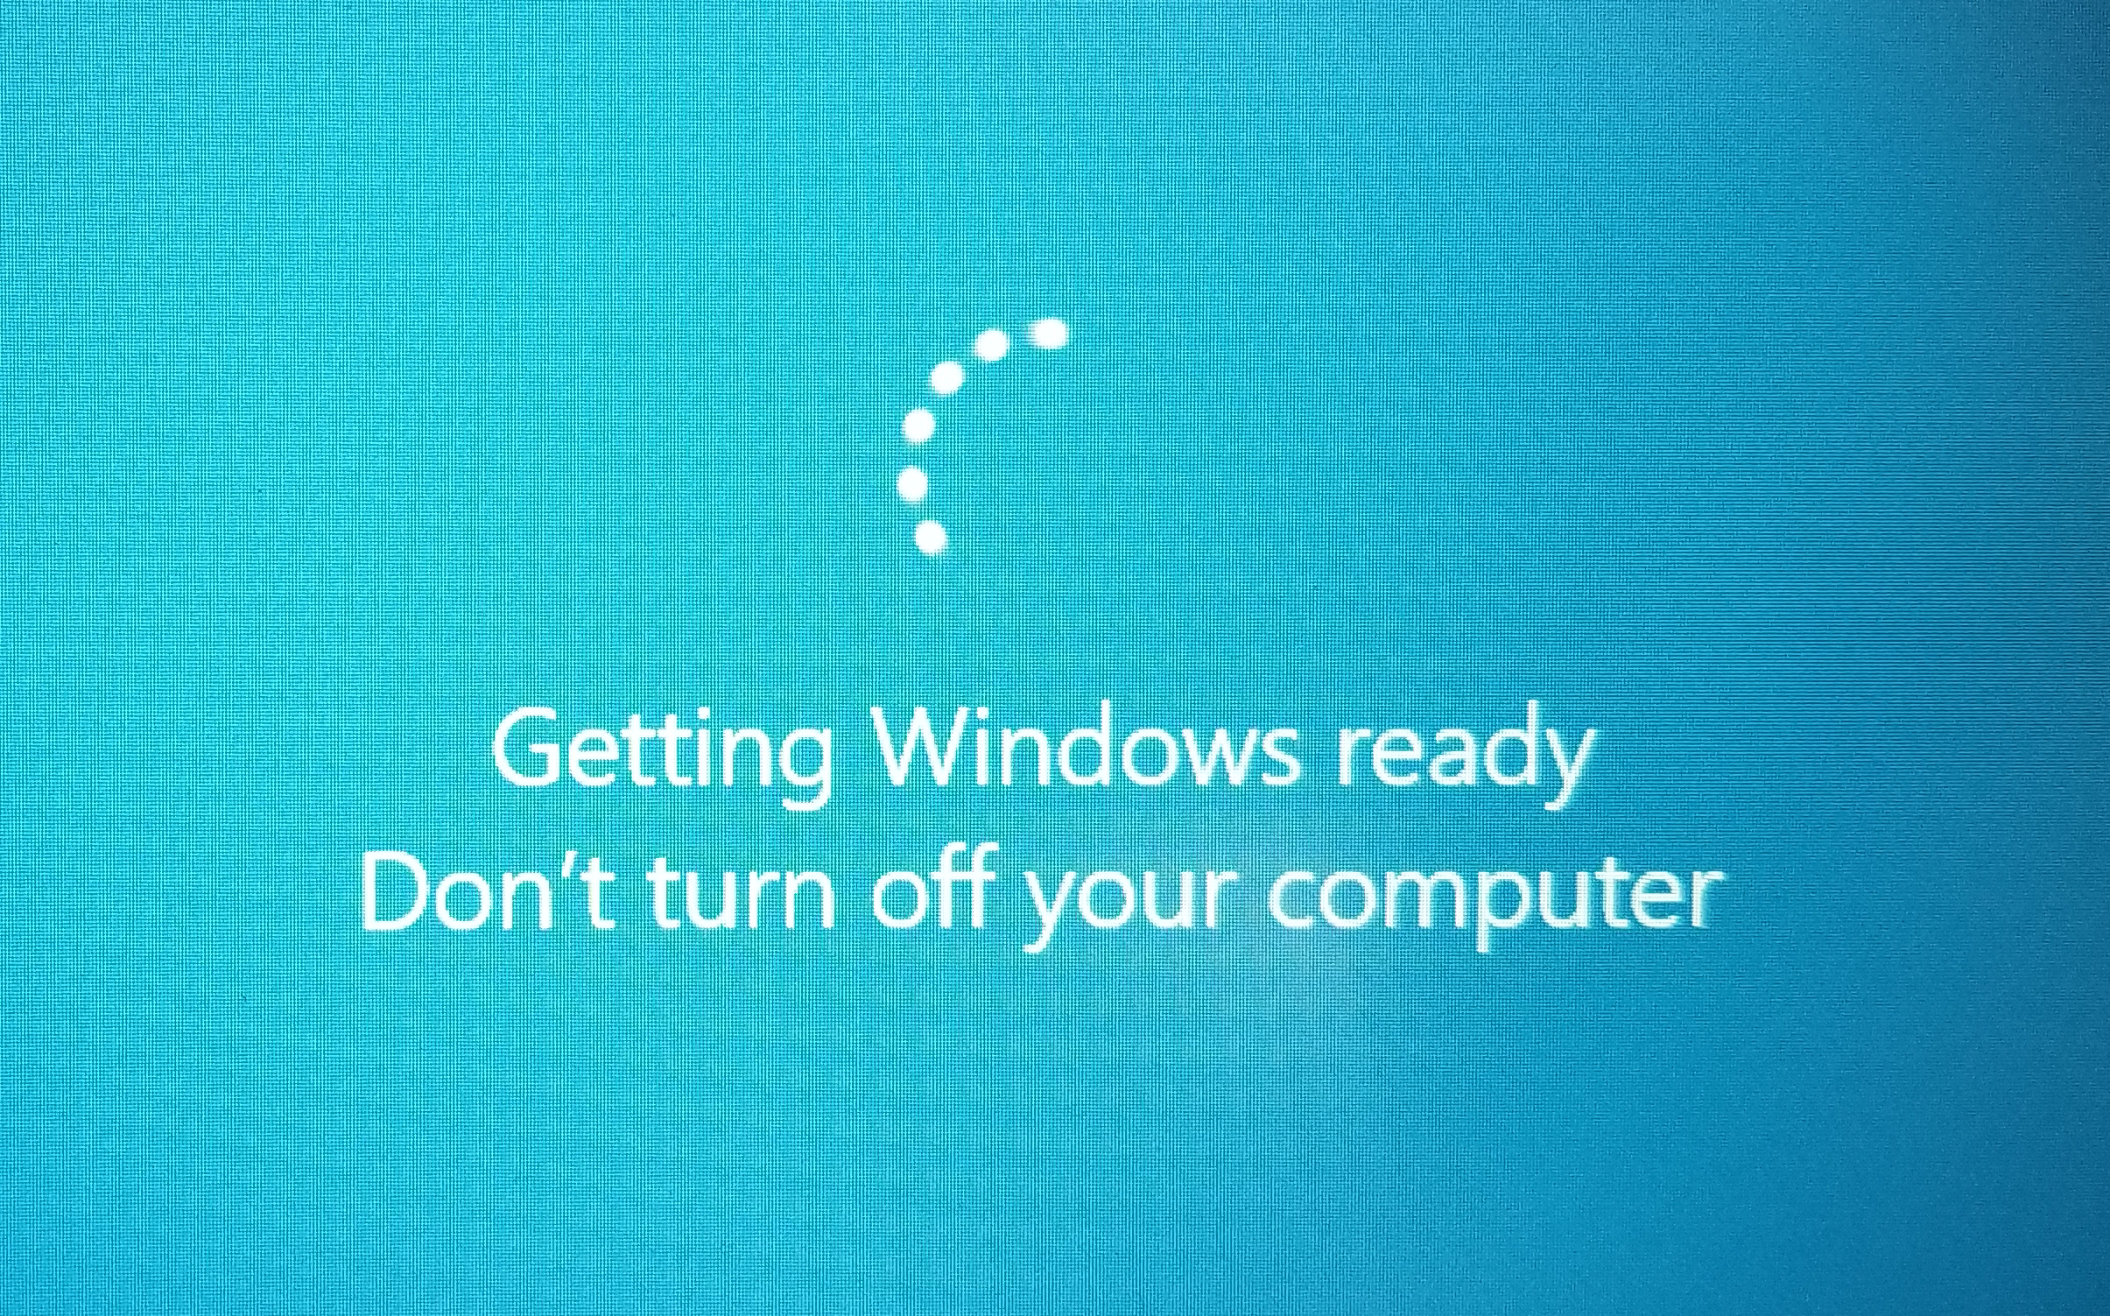
Get-HotFix

Slide 5

Quick & Dirty Code 6 Months Later

Slide 6
Set-Content ‘Information to Cover’
Functions and Script Modules
Parameters
Parameter Validation
CmdletBinding
SupportsShouldProcess
Pipeline Input
Error Handling
Module Manifest
Custom Formatting
And More ☺
Notes:
Source: The abstract / synopsis for this session.
https://powershelldevopsglobalsummit2018.sched.com/event/CnMp/writing-award-winning-powershell-functions-and-script-modules
Do what you say your going to do.

Slide 7

Start-Process ‘Demo’
Demo Code: github.com/mikefrobbins/Presentations

Slide 8
Introduction
Think
Plan
Learning –ne Searching the Internet
Stealing (I mean borrowing) Code
What Problem are you trying to solve?
Don’t Reinvent the Wheel
Don’t Overcomplicate Things
Notes:
More often than not, I see people start writing code before putting any thought into it whatsoever.
They have no plan which means they plan to fail.
If they don't know how to do something, they search the Internet in an attempt to shortcut the process of learning for themselves. Instead of shortcutting the process, they're actually shortchanging themselves.
Always give credit when using other peoples code.
Why are you writing this function or building this tool? What problem are you trying to solve? Before reinventing the wheel, determine if someone else has already written something that could be used or built upon.
Don't overcomplicate things. Keep it super simple and use the most straight forward way to accomplish a task.

Slide 9
Thought Process
Aliases and Positional Parameters
Readability
Unnecessary code
Attention to Detail
Clarity
Manageable Steps
Simplicity
Notes:
Avoid aliases and positional parameters in scripts and functions and any code that you share.
Format your code for readability.
Don't write unnecessary code even if it doesn't hurt anything because it adds unnecessary complexity.
Attention to detail goes a long way when writing any type of code, including PowerShell.
Begin with the end in mind and have a clear vision of what you're trying to accomplish before writing any code.
Once you know what the end result is that you're trying to achieve, break the process down into smaller, more manageable steps.
This is a great way to simplify anything that you're trying to accomplish without becoming overwhelmed and writing PowerShell code is no exception.

Slide 10
Create a Script or Function?
Tool Oriented
Autoloading
NuGet Repository
Proprietary Data
Opensource
Ideas and Suggestions
Contributions
Better Code
Notes:
Whenever possible, I prefer to write functions because to me they're more tool oriented.
I can place them in a script module, place that module in the PSModulePath and with the module autoloading functionality that was introduced in Windows PowerShell version 3, I can simply call a function instead of having to remember where it's saved, unlike a script.
With PowerShellGet in PowerShell version 5, it's also easier to share and distribute modules in the PowerShell Gallery or in a private NuGet repository.
I presented a session on PowerShellGet at the PowerShell Summit in 2015 in you're interested in learning more about it.
http://mikefrobbins.com/2015/04/23/powershellget-the-big-easy-way-to-discover-install-and-update-powershell-modules/
I write my functions generically without hardcoding any proprietary data such as server names or credentials in them.
I place those functions into script modules which makes them easier to share as I previously mentioned.
By not including any proprietary data, it makes them easier to open source.
I write caller scripts (scripts that call the functions) where I place the proprietary information and those scripts aren't shared with anyone outside of my organization.
I've also received some great ideas and suggestions for changes to my code over the years by blogging about it and placing it on GitHub.
Who knows, someone else may even fix problems for you or add additional functionality if your code is open sourced.
Ultimately, your organization ends up with better code by allowing it to be open sourced because you're not going to share something that's quick and dirty.

Slide 11
What is a Function?
Wrong Conference ☺
List of Commands or Instructions
Perform a Specific Task
Packaged as one unit
PowerShell Function
Retrieve Data
Process Data
Output Data
Modular
Notes:
If you don't already know the answer to this, you're probably at the wrong conference.
A function is a list of commands or instructions that perform a specific task, packaged as one unit.
A PowerShell function should do one thing and do it well. It should do one and only one of the following.
Retrieve data
Process data
Output data
Adhering to this list allow your functions to be modular.
More information about what a function should and shouldn't do can be found in this Hey, Scripting Guy! Blog article.
https://blogs.technet.microsoft.com/heyscriptingguy/2013/04/07/do-one-thing-and-do-it-well/
For more information about what a PowerShell function is, see the about_Functions help topic
https://docs.microsoft.com/en-us/powershell/module/microsoft.powershell.core/about/about_functions

Slide 12
Function Naming
Pascal Case Name
Capitalize First Letter in Verb
All Terms in Noun
Approved Verb
Import Module Warning
Singular Noun
Prefix Noun
Naming Collisions
Example
ApprovedVerb-PrefixSingularNoun
Notes:
Use a Pascal case name with an approved verb and a singular noun.
Capitalize the first letter of the verb and all terms in the noun.
Be sure to use approved verbs for your functions otherwise a warning will be generated when your module is imported.
I also recommend prefixing the noun.
Example: ApprovedVerb-PrefixSingularNoun

Slide 13
Resume-Process ‘Demo’
Demo Code: github.com/mikefrobbins/Presentations

Slide 14
Variables
Static Values
Variables
Parameters
Hungarian Notation
$strOutFile
$OutFile
Naming
Variable Reuse
Notes:
Don't hard code values (don't use static values), use parameters and variables.
Don't use Hungarian notation! (Example: $strOutFile should be $OutFile)
Do use a meaningful name for your variables
Don't reuse variables

Slide 15
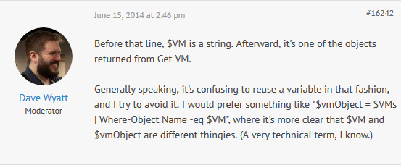
Don’t Reuse Variable Names
Source: https://powershell.org/forums/topic/redundancy-of-code-in-advanced-function/

Slide 16
Parameter Naming
Built-In Cmdlets
Azure Cmdlets
Plural Parameter Names
Avoid Them
Single Element
Multi Element
Pascal Case
Notes:
Use the same parameter names as the default cmdlets for your parameter names whenever possible.
Avoid using plural names for parameters than can accept a single element (even if it can accept more than one item).
Some documentation suggests that plural parameter names should only be used when the parameter is always a multi-element value (which is probably never).
Use Pascal case for parameter names.

Slide 17
Resume-Process ‘Demo’
Demo Code: github.com/mikefrobbins/Presentations

Slide 18
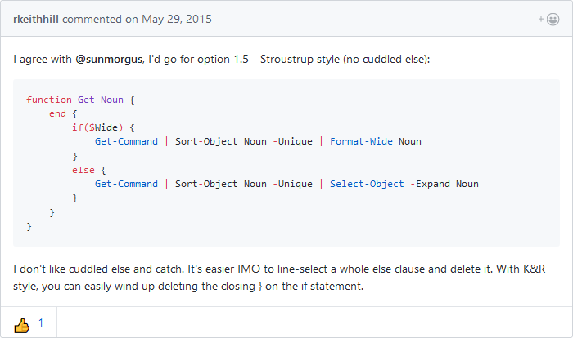
Where to put braces?
Source: https://github.com/PoshCode/PowerShellPracticeAndStyle/issues/24#issuecomment-106860973

Slide 19

Great Code 6 Months Later

Slide 20
Select-Object –Property ‘Resources’
PowerShell Documentation
PowerShell Best Practices and Style Guide
Microsoft Virtual Academy
PowerShell.org
GitHub
User Groups & Blogs
Twitter
Slack

Slide 21




Get-Contact –Identity ‘Presenter’
Blog: mikefrobbins.com (or MrPowerShell.com)
Twitter: @mikefrobbins
LinkedIn: www.linkedin.com/in/mikefrobbins
E-Mail: See mikefrobbins.com/about/
User Group: mspsug.com (or MsPowerShell.com)

